Slide 1


Microsoft Power BI

Slide 2

Relaunch the add-in
Microsoft Power BI
After you install the add-in, you can launch it by choosing the add-in button on the Insert tab
On the Insert tab
Insert
My Add-ins
Need more help?
Return to your internet browser or copy this link into your browser:
https://pages.store.office.com/addinsinstallpage.aspx?rs=en-US&assetid=WA200003233&isWac=True&ui=en-US&ad=US

Slide 3
BI Dashboard Creation:
Expense Tracker Dashboard
Author: Shubham Sharma

Slide 4
Table of contents
01
02
03
04
05
Data Overview
Intro
Task Details
SharePoint Integration
Creating Viz

Slide 5
Introduction
Creating a Power BI dashboard for managing personal expenses. Imagine transforming raw numbers into a dynamic visual experience. We'll be working with expense documents from October, November, and December.

Slide 6
Task Details
Create a Power BI dashboard from the expenses documents from the SharePoint site.
Key Tasks:
Create Dashboards with creativity.
Connect Power BI to SharePoint.
Implement user-friendly document and sheet selection.
Automatic data refresh based on selections.

Slide 7
Data Overview
Zip contains expense documents of a person for the month of October, November and December .
Each document contains two sheets "INR" and "USD" , which indicates the "costs" column's currency type.
Column names are self explanatory .

Slide 8
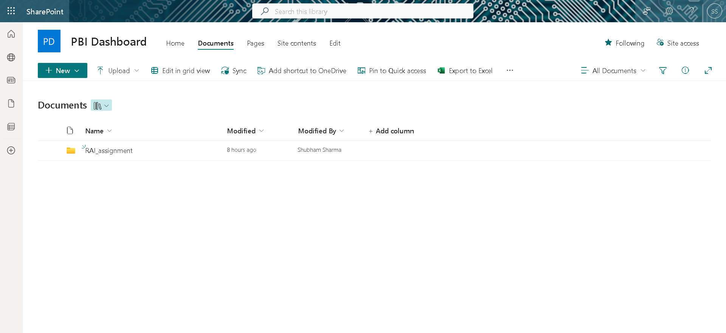
SharePoint Integration
Uploaded all the Excel files in SharePoint.

Slide 9
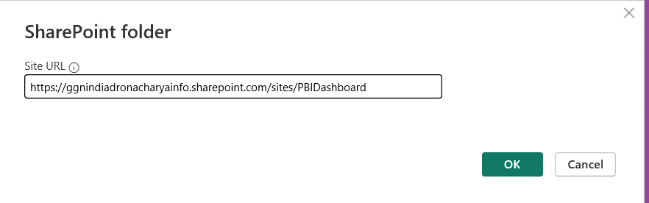
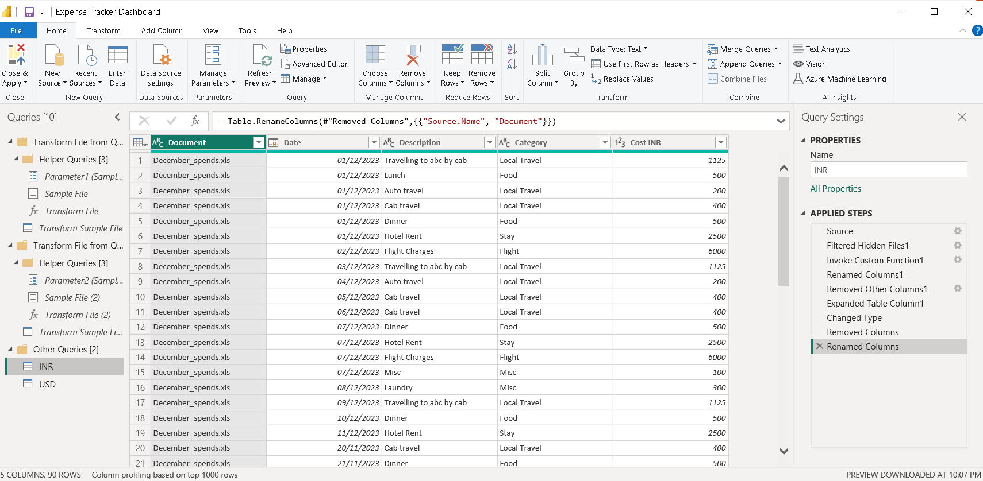
Connecting SharePoint Data to PBI
Pasting the SharePoint Site URL for establishing connection.
Then Combining & Transforming Data in Power Query.
Combined all the data from three files.

Slide 10
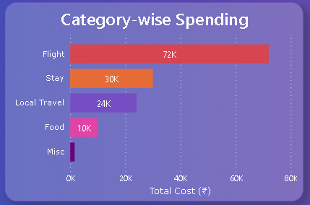
Creating Visualizations
1.Category-wise Spending :
Stacked Bar Chart:
X-axis: Categories
Y-axis: Total Cost INR
From the above visualization we can say that the subject spent most on Flights.

Slide 11
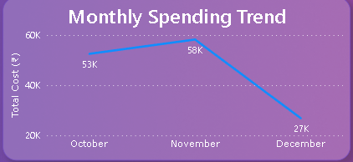
Creating Visualizations
2.Monthly Spending Trend:
Line Chart:
X-axis: Date
Y-axis: Total Cost INR
From the above visualization we can say that the subject spent most in November.

Slide 12
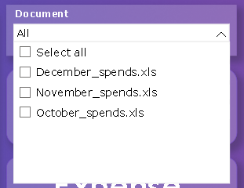

Creating Visualizations
Dropdown Menu:
Slicer:
Created a dropdown menu from which we can select the Data of Specific Excel File (i.e October_spends, November_spends, December_spends)
Month:
Slicer:
Slicer to get the results from any of the three Months.

Slide 13
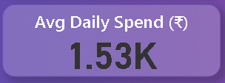
Creating Visualizations
Average Daily Spending:
Created a New Measure to display the average daily spending.
Average Daily Spending = SUM('INR'[Cost INR]) / COUNTROWS(RELATEDTABLE('INR'))

Slide 14
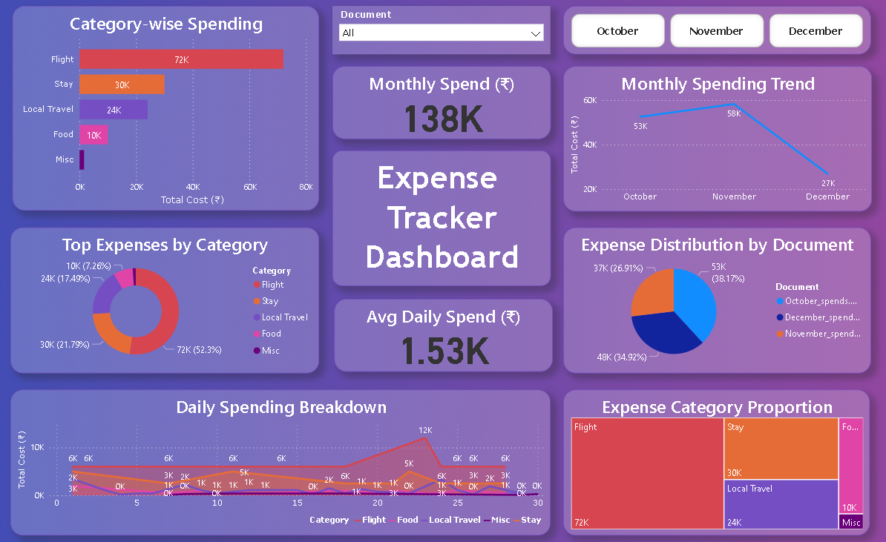
Dashboard

Slide 15
Thanks!

